Slide 1
Puzzle 1 - 50

Slide 2
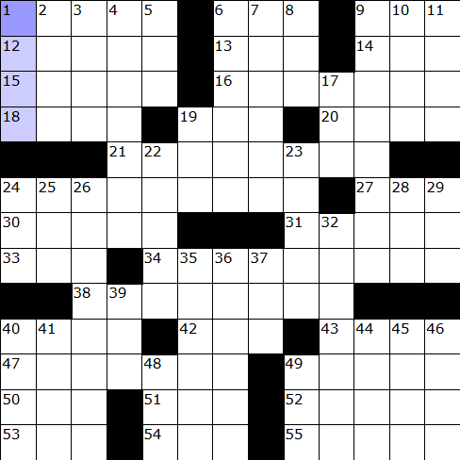
Crossword - 1

Slide 3
Across
1. Legendary stories
6. Uno
9. Pig's pad
12. Box
13. Business VIP
14. Pitching stat
15. Church walkway
16. Burst of bad temper
18. California wine valley
19. Make lace
20. Epochs
21. Caveman's era (2 wds.)
24. Concurrence
27. Time past
30. ____ Witherspoon of "Sweet Home Alabama"
31. Had
33. And so forth (abbr.)
34. Proposed as a candidate
38. Renovator
40. Pub drinks
42. Shade
43. Stood up
47. Childhood disease
49. Golfer ____ Woods
50. Bathroom rug
51. Tax org.
52. ____ eclipse
53. Lyric verse
54. Compass dir.
55. Printing machine
Down
Skim over
Opera solo
Struggle for breath
Books of maps
Behold
Gasoline classification
Tidy up
Chunk of eternity
Military rank
Faithful
Sweet potatoes
17. Children's game
19. Actor ____ Hanks
22. Adolescents
23. Make amends
24. Common verb
25. Acquire
26. Make again
28. Goodness!
29. Strange
32. Soldier
35. Additional ones
36. Styling foam
37. Wrath
39. Highway curve
40. Military supplies
41. Show the way
44. Leer
45. Oceans
46. Miscalculates
48. Recline
49. Recipe unit (abbr.)

Slide 4
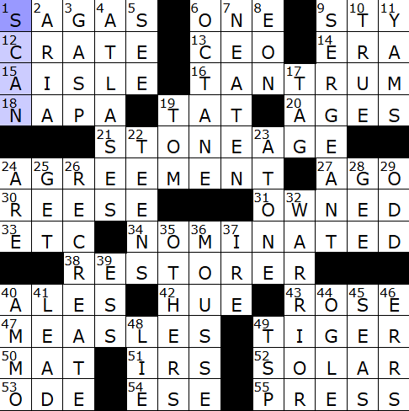

Slide 5
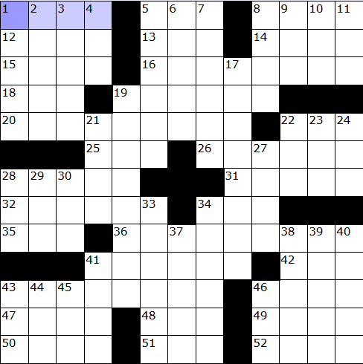
Crossword - 2

Slide 6
Across
1. Hurt
5. Make a selection
8. Frank
12. Legal hold
13. Bad grade
14. Gambling city
15. School groups (abbr.)
16. Became more profound
18. That woman
19. River mouths
20. House locations
22. Large antelope
25. Washington, DC time zone
26. Food allotment
28. Knife feature
31. Australian dog
32. Witty reply
34. Chaps
35. Poetic work
36. Big, hairy spider
41. India’s Mother ____
42. Pen point
43 Abnormally sensitive
46. Linger
47. Little piggies
48. Self
49. Broadcasts
50. Egg on
51. High explosive (abbr.)
52. Scottish loch
Down
19. River mouths
19. River mouths
19. River mouths
19. River mouths
19. River mouths
19. River mouths
19. River mouths
19. River mouths
19. River mouths
19. River mouths
19. River mouths
19. River mouths
19. River mouths
19. River mouths
19. River mouths
19. River mouths
19. River mouths

Slide 7
